Slide 1
Land cover classification and Planet imagery
Feb 11, 2019

Slide 2
Plan for using Planet imagery

Slide 3
Purpose of Planet images: create validation/training data
Validate crop timing information
Need high temporal resolution
My current method involves stepping through images and manually entering estimated planting, harvest dates for each field
Validate land cover classification for single vs double cropped soy (for places known to be soy)
Need because want to report difference in crop timing behavior for different cropping intensities
Current land use map doesn’t separate single vs double cropping well
Training data for land cover classification of soy vs nonsoy agriculture
Important because ‘bad’ timing estimates are usually due to misclassified land use
We have very few training points for nonsoy agriculture
If need to create training data for this from Planet, need calibrated images from a consistent set of satellites, need to calibrate with Sentinel 2?
Validate land cover classification agriculture vs natural veg
Important because ‘bad’ timing estimates are usually due to misclassified land use

Slide 4
Training data for land cover classification of soy vs nonsoy agriculture
Need this because:
False positive of soy in land use map is very high (around 50 – 60%), and we don’t want to report timing information for agriculture that’s not soy
Want to make sure the Planet imagery downloaded for timing/SC/DC validation purposes is indeed soy
However, the training data for non-soy agriculture is very sparse (500 SC/DC soy points, 15 nonsoy points per year)
Currently, train and apply classifier only for individual years; maybe pooling all years’ training data will help
Is it possible to train a soy vs nonsoy classifier in e.g. Kansas and use it in Brazil? (Crop timing issues…)
Is it possible to visually identify soy vs other agriculture from Planet images? (i.e. create more training points from Planet?)
Year | Overall accuracy | True positive | False positive
2014 | 95 | 453/(453+17) | 7/(11 + 7)
2003 | 92 | 348/(348+13) | 16/(14+16)
2004 | 90 | 324/(324+23) | 10/11
2007 | 96 | 397/(397 + 2) | 14/(14+7)
2017 | 96 | 412/(412 + 8) | 9/(9+8)
For downloading Planet images known to be soy, because false positive is so high, can’t rely on land use map to target soy-only agri.
Currently, only downloaded Planet images over farms that are known to be soy
Could also download Planet images with a high concentration of soy training points, but the training points don’t cover all of Brazil

Slide 5
Center pivot classification

Slide 6
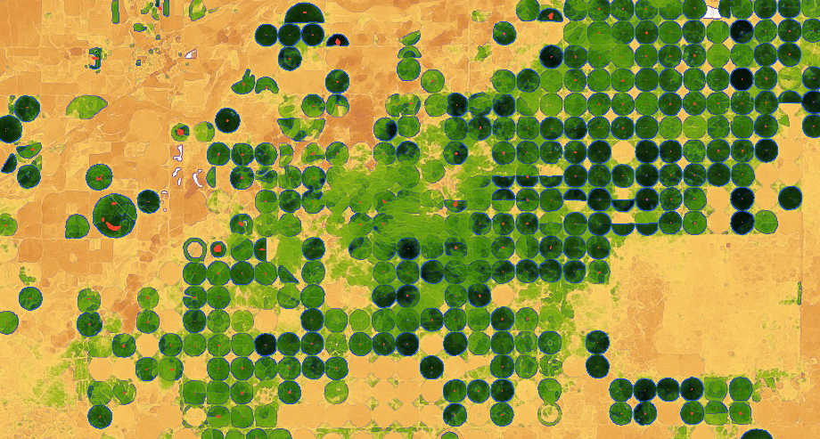
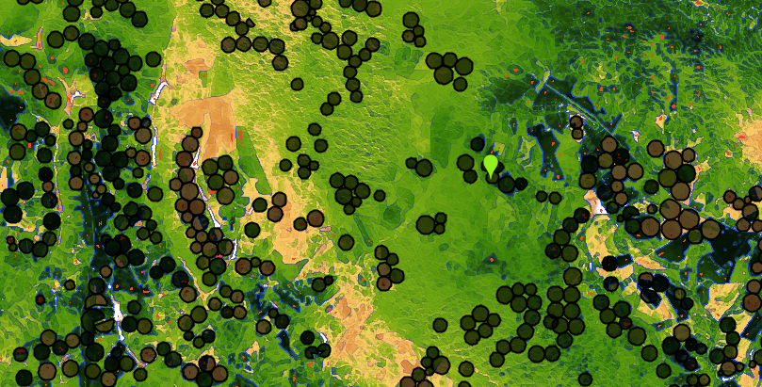
Center pivot detection in Brazil
Need to detect center pivot because only have one year of center pivot data
Method is based on edge detection. Red = center pivot’s centroid. Black circles = 2014 center pivot data
Kansas, using Landsat 8 day EVI in April 2013
Brazil, using Landsat 8 day EVI in April 2013
Observations:
No obvious ‘out of season’ time during which irrigated would be green and rainfed would be yellow
Size of center pivots is very uniform in Kansas but more varied in Mato Grosso, is a problem for creating a single kernel size in edge detection
Irregularly spaced center pivot and heterogeneous natural vegetation make it hard to pinpoint actual center pivot (problem for edge detection). False positive and false negatives are very high
reduceToVectors to convert from detected pixels to features is not scalable in GEE
Potential solutions:
Object oriented classification; machine learning. Other solutions?

Slide 7
Automated detection Planet imagery characteristics

Slide 8
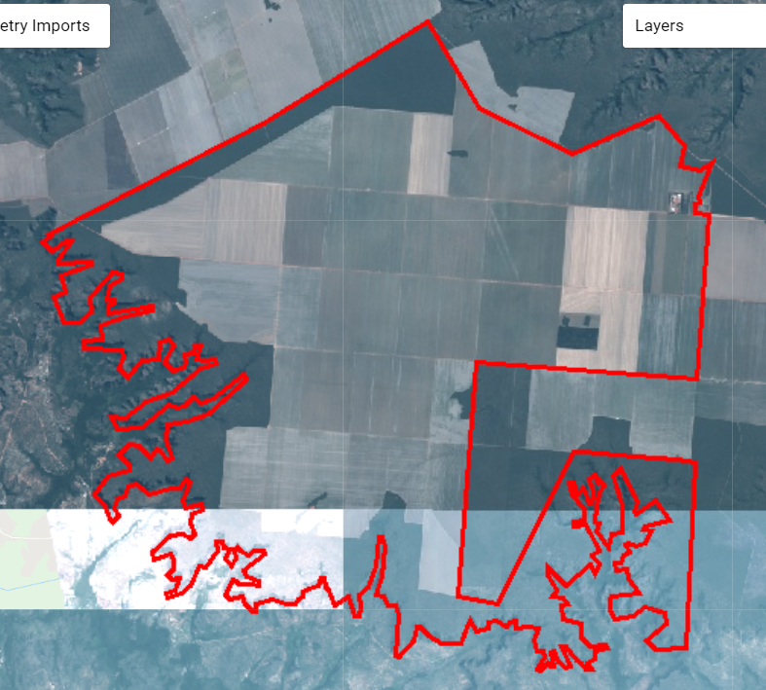
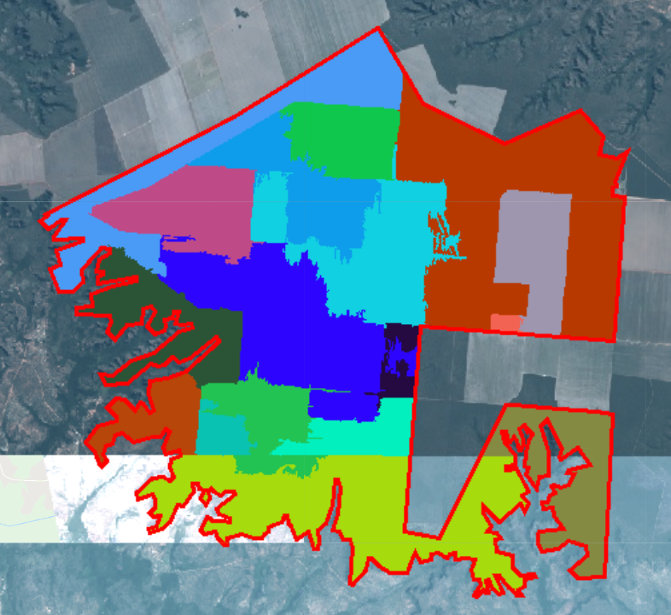
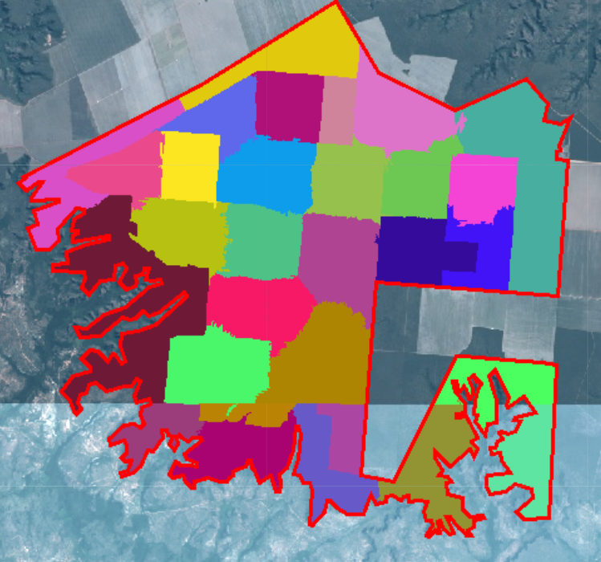
Automated workflow?
Currently, manually examine and download Planet images online; manually upload as GEE assets; manually divide Planet image into fields (each has its unique timing), manually enter estimated planting/harvest dates
Automation:
Planet Python API and GEE connection
Download images that are cloud-free over specific regions?
Automatically upload as GEE asset, or a way to use the images in GEE without uploading as asset?
Use image segmentation algorithm to separate image into agricultural fields
For each field, do simple peak detection method: find dates with the five highest EVI values, look at how dates are spread over the year. This will determine single vs double cropping. Other peak detection method?
A way to get planting/harvest date automatically?
Mosaic of Planet Scope cloud free images, 2017 - 2018

Slide 9
Planet Scope satellite calibration

Slide 10
Planet Scope vs Rapid Eye images
How to calibrate to each other to use to create a single timeseries?
Need to calibrate to Sentinel to get accurate EVI? (what calibration method/tools to use?)
Commercial high resolution satellites that are useful for calibration?
They are top of atmosphere – is there an atmospheric correction algorithm available?
Existing cloud filtering algorithm for Planet Scope and Rapid Eye?
Python API – filter for cloud cover over specific regions of the image?

